Slide 1
CSI Rep
Ver 1.0

Slide 2
Game flow (House)
Enough Favor Point?
Flow with
favor points
(progress in case)
Middle of a case
Consume FP and move on case
Yes
No
Actions without FP
(open loop)
-request item
+Favor Point
Send to Ward and earn FP
-medicine
+request item
-energy
+money
-energy, money
+medicine
Give Medicine
Lab Treatment
Prepare
medicine
Actions to earn FP
(open loop)
Matching
Catching

Slide 3
Game flow (Miami) Pt.1
Buy deco, station to earn Rep
Expand lab to earn Rep
Buy Avatar item to earn Rep
Enough Rep?
Flow with
rep
(progress in case)
End of a case
Consume Rep and move on case
Yes
No
Complete Rep quest and earn Rep
Complete empathy quest and earn Rep
*Reach search milestone and earn Rep (TBD)
Buy deco, station
Expand lab
Buy Avatar item
Help Friend
Dig tile
Remove obstacle
Reach higher level
Hoard funding
Hoard supply
Process evidence
Question suspect
Actions to earn FP
(open loop)
Actions to earn FP
(closed loop, within case)
Element that good to have for CSI rep

Slide 4
Game flow (Miami) Pt.2
Actions without FP
(open loop)
-energy
+supply, funding
-energy
+supply
Visit Friend
Replay case
Collect supply
-energy
+funding
-energy
+funding
-supply
+progress
-energy
+progress
Dig tile
Remove
obstacle
Process evidence
Question suspect

Slide 5
Comparison between House and Miami
House MD
CSI Miami
Main exchange between IGC and energy is outside of case
Plenty outside case progress actions
Beside main case, player have tons of small case to deal with
Player need to spend IGC outside a case
Main exchange between IGC and energy is inside of case
Limited outside case progress actions
Most of the action are inside case, need replay to access to them
Player is not required to spend IGC outside a case

Slide 6
CSI Rep Goal
It’s all about searching more tile and spending more funding
Aim:
Increase location completion rate and funding spent outside a case

Slide 7
Source of rep
Quests
Incase: empathy quest
Outside case: rep quest
*Rep item:
Deco & station
Avatar item
*This one is TBD, it can also be included in rep quests (e.g. quest rewards 2 rep points for buying certain items) instead of add rep points of each item.
Social:
Visit friends
*Case milestone
*This one is TBD

Slide 8
UIs will be impacted
Main UI
Rep icon
*Milestone for location complete rate
Quest UI
Need a quest frame with rep icon

Slide 9
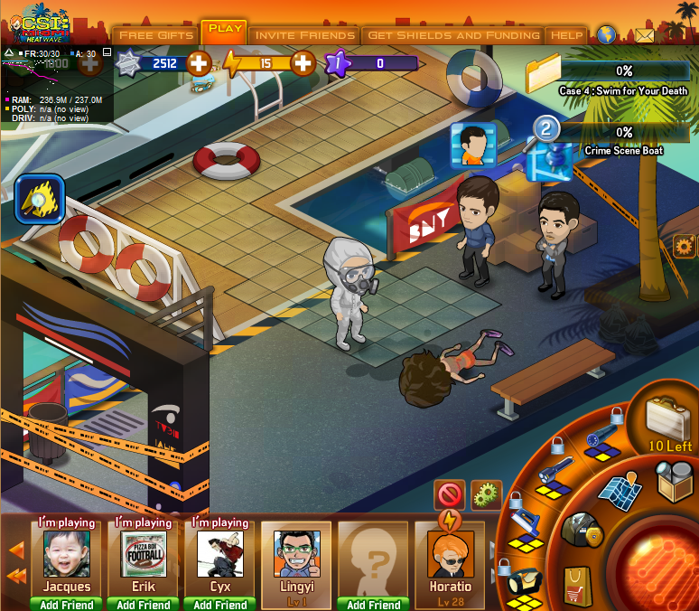



Main UI
18

Slide 10
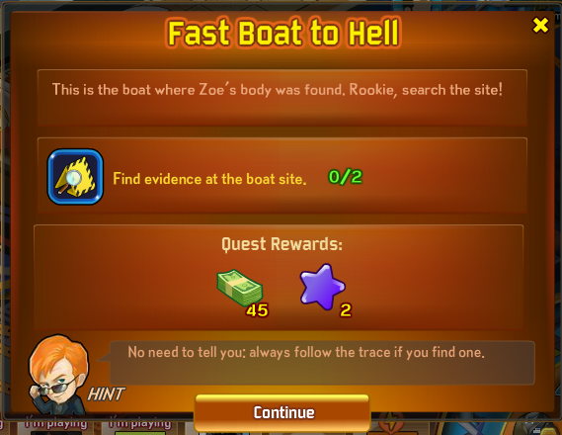
Rep quest UI
18

Slide 11
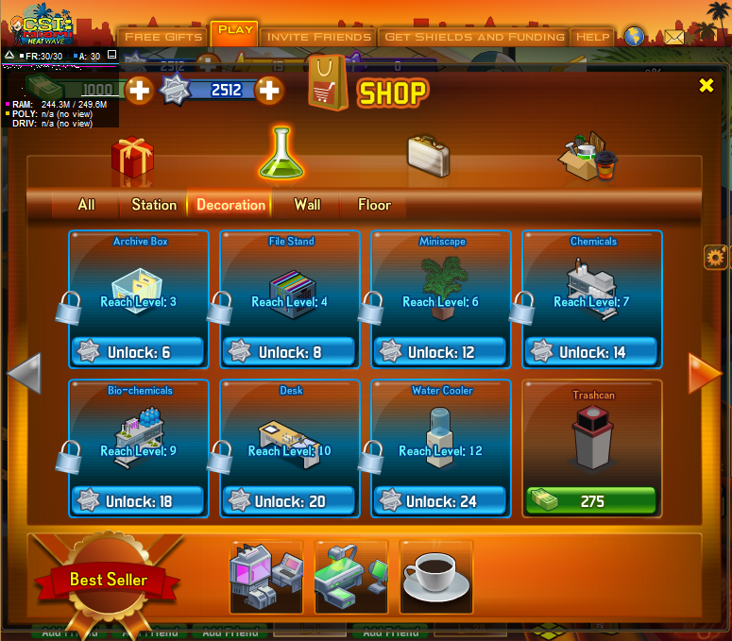
UI-*Rep item
Trash can
Lab decoration, add 1 on purchase.

Slide 12
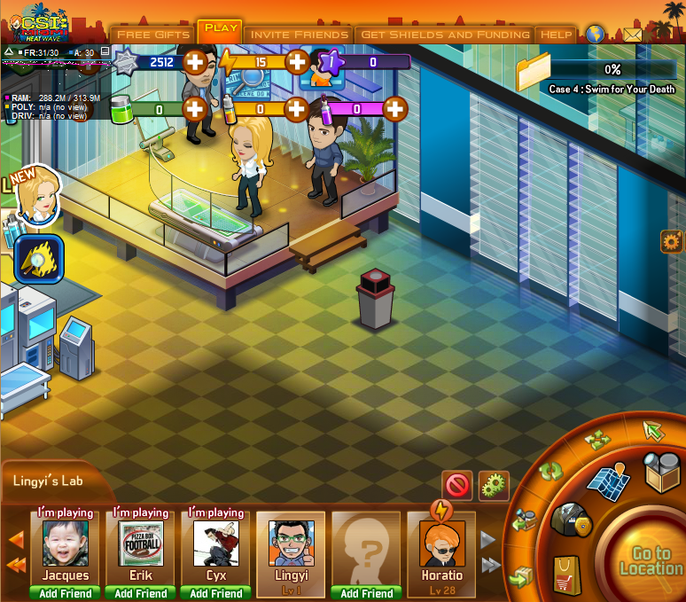
UI-*Rep item
18

Slide 13
UI-*Rep item
19
+1 CSI Rep

Slide 14
Plan A: Case UI as Rep gate
Player need to accumulate enough rep to progress to the next case
Otherwise player will be stuck at previous case with all location available

Slide 15
With Rep and without Miami Map
Direct player to Lab instead of next case
Have Horatio (or an icon on Main UI) in lab to switch to next case
Player can still dig the rest of the tile and finish quests

Slide 16
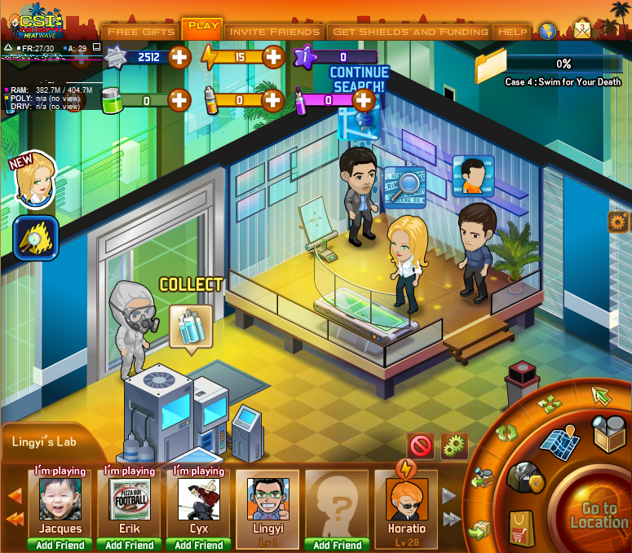

UI
19
New case available!
Only shows after player finishes a case

Slide 17
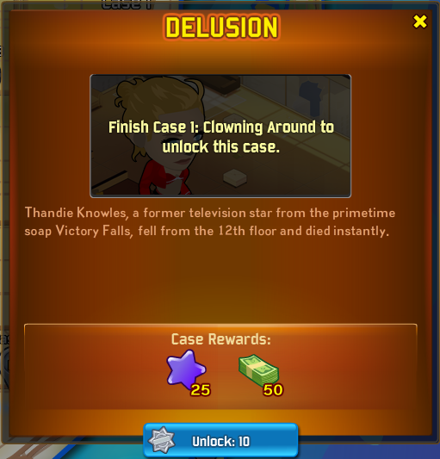
UI don’t have enough rep
19
Need 30 to unlock this case

Slide 18
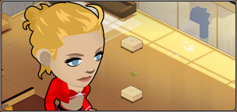

UI have enough rep
40
Play : 30

Slide 19
Rep setup
Make sure player will have enough rep to next case if he finish all quests within a case
We can use rep quest to guide player do things we want, such as charge shields
Player will always have several rep quest to be finished
Complete requirement for these quests will increase progressively

Slide 20
Plan B: Questioning as rep gate
Keep normal case flow (from one case to the next)
Player need spend CSI rep to ask question
Implement 1: keep the guessing question mechanic
Implement 2: make the questioning linear, only the right question available
Otherwise player will be stuck at previous case with all location available

Slide 21
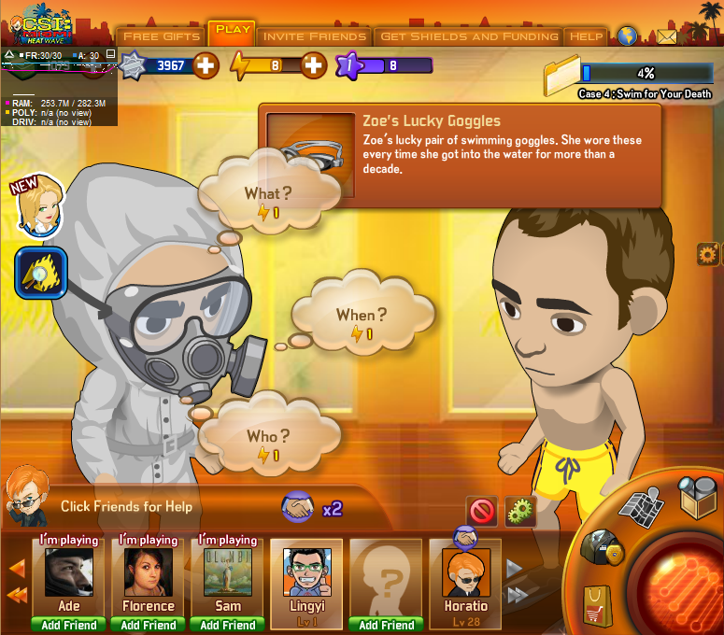
UI
0

Slide 22
UI-not enough rep
0
Need more CSI Rep
X
You need CSI rep in order to ask the question, get some now?
0/1
30

